Slide 1
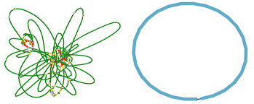
ONT Genome Assembly
Tutorial 6
Vincent Somerville
2.11.2021

Slide 2
Why are we doing ONT sequencing and assembly?

Slide 3

We were dreaming of circular assemblies

Slide 4
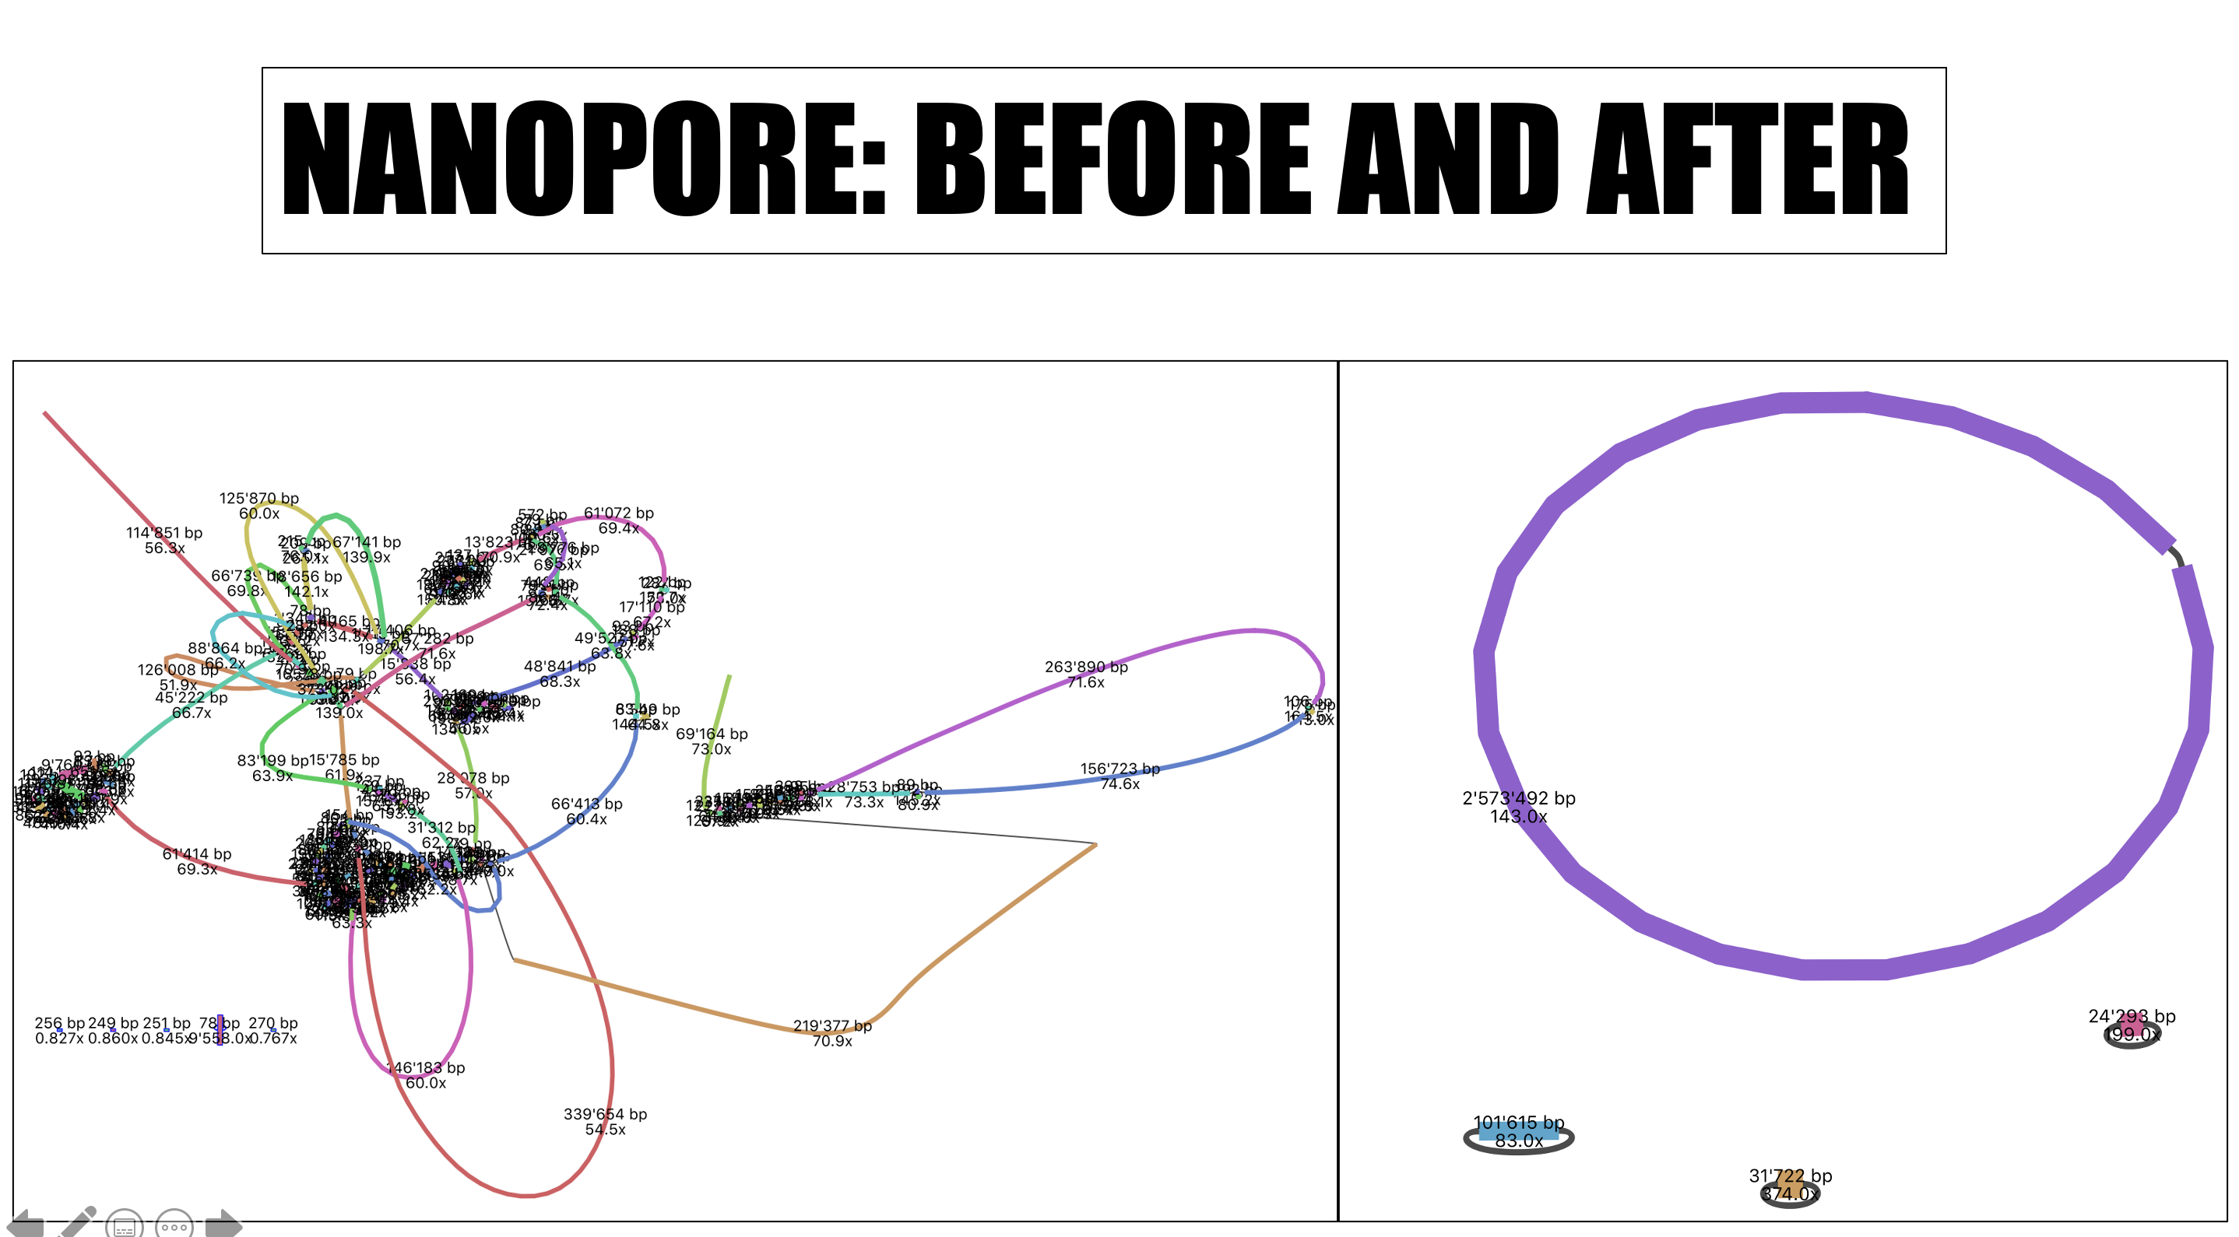
We were dreaming of circular assemblies
But why?
Image from Marine Bugnon (SAGE 20-21)

Slide 5
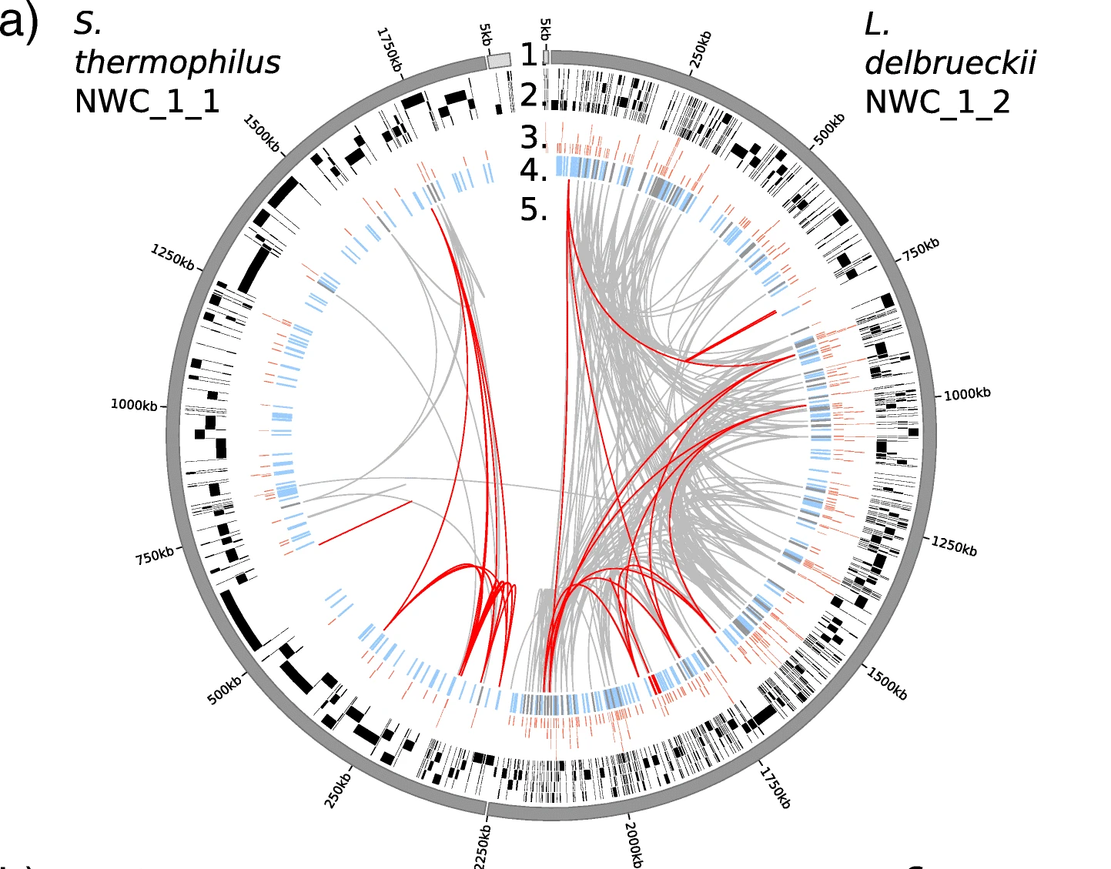
We were dreaming of circular assemblies
But why?
- In the assembly gaps we might have missing genes
- In the assembly gaps we might copy number variations (#of 16s genes)

Slide 6
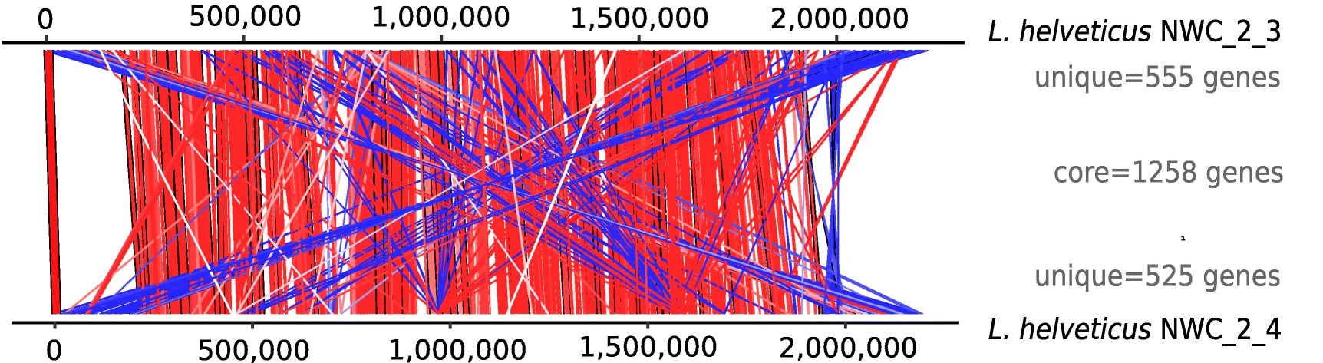
We were dreaming of circular assemblies
But why?
- In the assembly gaps we might have missing genes?
- In the assembly gaps we might copy number variations (#of 16s genes)?
- With a closed circular assembly we can see if the genome is in synteny (same ordering of genes)

Slide 7
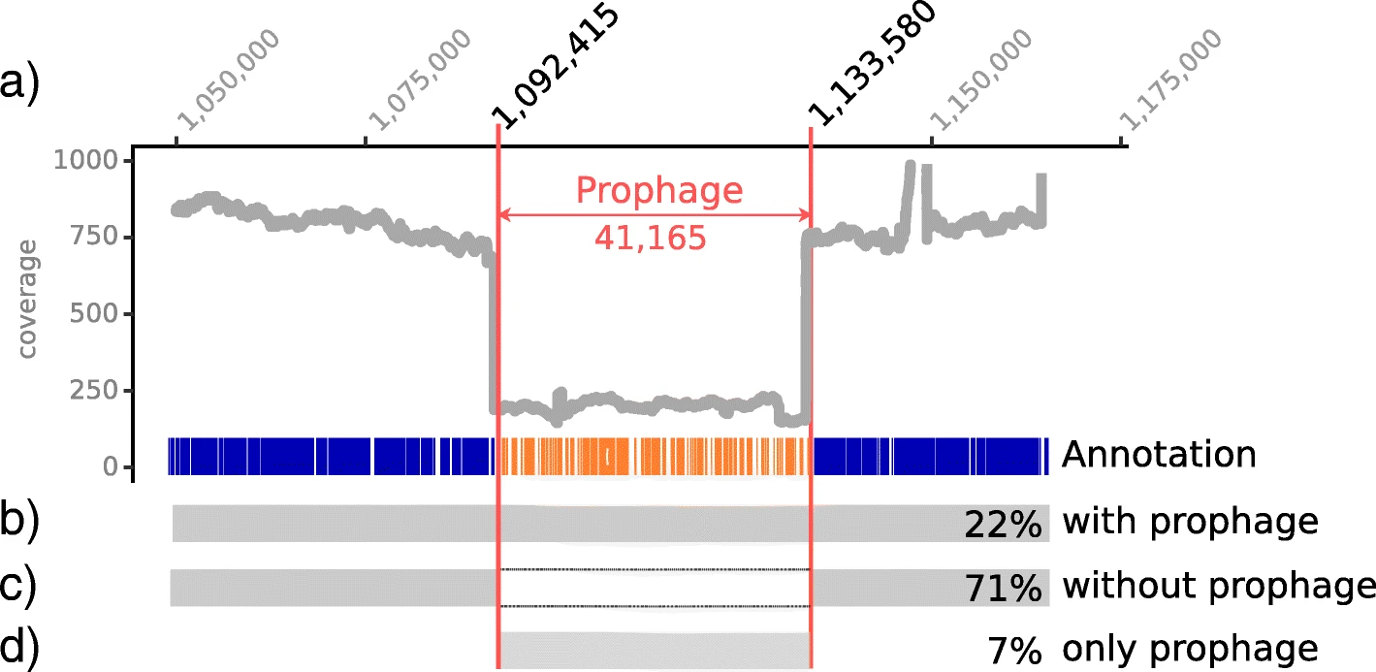
We were dreaming of circular assemblies
But why?
- In the assembly gaps we might have missing genes?
- In the assembly gaps we might copy number variations (#of 16s genes)?
- With a closed circular assembly we can see if the genome is in synteny (same ordering of genes)
- With long reads we can detect the genomic context of certain features (e.g. temperate phages)

Slide 8
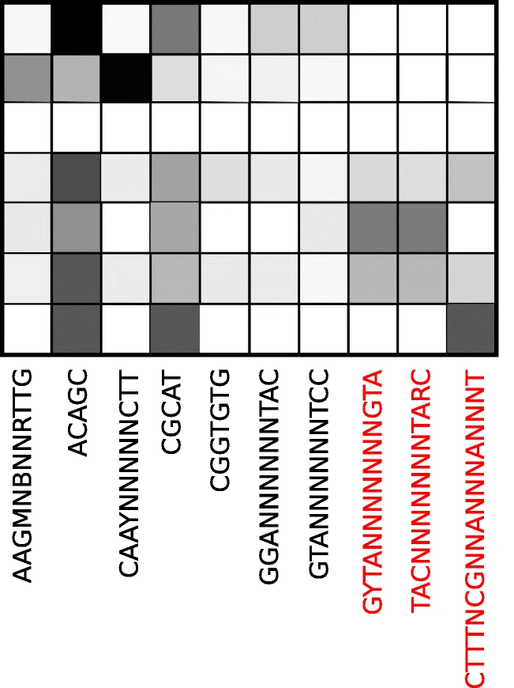
We were dreaming of circular assemblies
But why?
- In the assembly gaps we might have missing genes?
- In the assembly gaps we might copy number variations (#of 16s genes)?
- With a closed circular assembly we can see if the genome is in synteny (same ordering of genes)
- With long reads we can detect the genomic context of certain features (e.g. temperate phages)
- With ONT data we can also predict DNA methylation which can be used e.g. to assign a plasmid to a genome

Slide 9
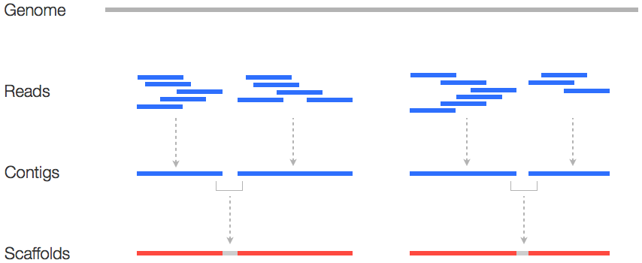
How do we do this?
1. use ONT reads for scaffolding
Genome
- Illumina might be missing regions completely!
Illumina eads
Illumina eads
Ilumina contis
ONT reads for scaffolding

Slide 10
How do we do this?
1. ONT reads for scaffolding
Genome
- Illumina might be missing regions completely!
Illumina eads
Illumina eads
Ilumina contis
ONT reads for scaffolding
2. ONT for assembly and Illumina for polishing
Raw ONT reads
Tutorial 5: Raw read analysis and filtering
ONT reads
Filtered ONT reads
Tutorial 6: Genome assembly
ONT assembly (complete+circular)
ONT assembly (complete+circular)
ONT + Ilumina
polished
+
Tutorial 7: Genome polishing
Final assembly

Slide 11
2. What will we do today? Step-by-step

Slide 12
Step-by-step Oxford Nanopore (ONT) assembly
Tutorial 5: Raw read analysis and filtering
Tutorial 6: Genome assembly
Tutorial 7: Genome polishing
Tutorial 8: Genome annotation and start alignment

Slide 13
- Raw read distribution (awk and r)
- calculate number of reads needed
- Raw read distribution (awk and r)
Raw
ONT fastq
filtered
ONT fastq
Raw
genome assembly
- Raw read filtering (with filtlong)
- ONT genome assembly (with flye)
Step-by-step: ONT analysis
ONT genome polishing by
mapping ONT (with graphmap)
polishing genome (with Racon)
polishing QC:
raw read mapping
changes during polishing (with Quast)
- annotate genome
- identify dnaA
Complete
& polished
& startaligned
genome
Complete & polished genome
ONT-polished
genome
- start aligning genome
Illumina genome polishing by
mapping ONT (with bowtie2)
polishing genome (with Pilon)

Slide 14
3. What are we doing now?

Slide 15
- Raw read distribution (awk and r)
- calculate number of reads needed
Raw
ONT fastq
filtered
ONT fastq
- Raw read filtering (with filtlong)

Slide 16
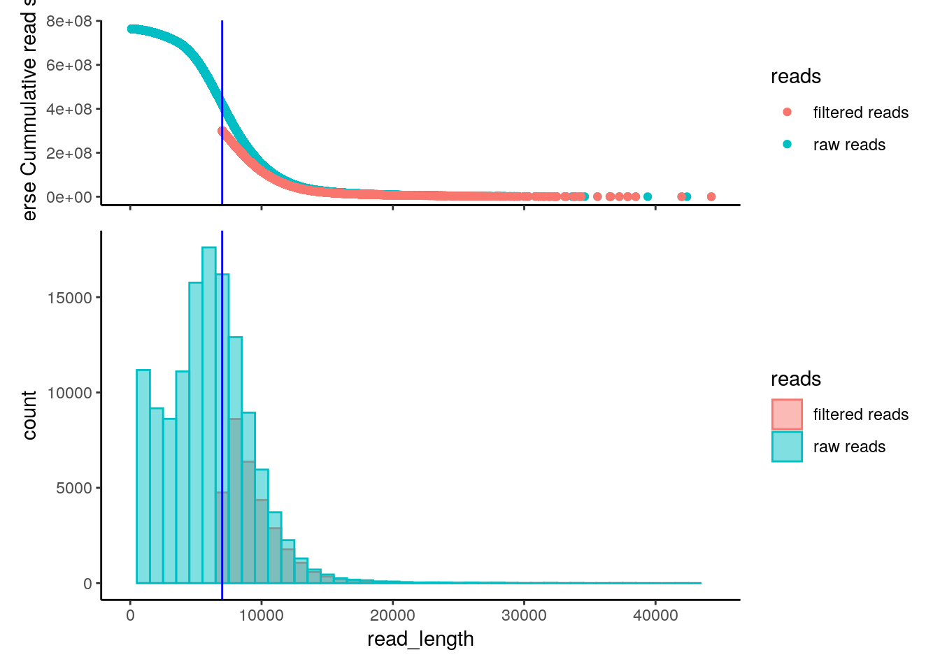
Sneak peak
This is what you will get.
Post it in the #results channel so we can discuss!

Slide 17
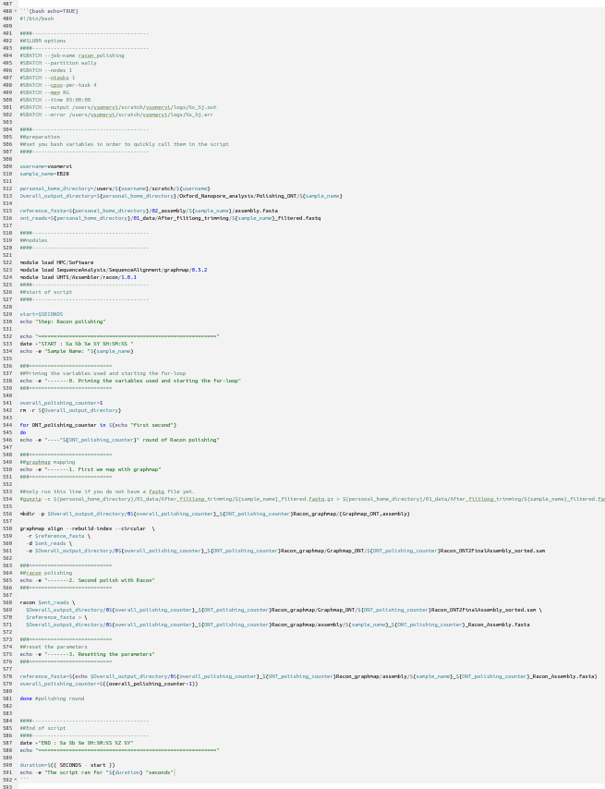
Some coding/scripting hints
By the end of today you will write something like this!
200 lines of code
In order to avoid copy and paste errors in long scripts we can use Variables!

Slide 18
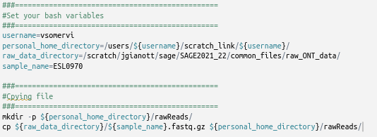
How can we do this?
We safe the location, file or name of something we use over and over again as a variable.
e.g. the first thing we will do today is copy your files from a raw_data_directory
to your
personal_home_directory

Slide 19

Now it’s your go!

